Slide 1

Stage 5
They Told Me This Was A Hoser Match
Course Designer: Eric Beerbaum
They Told Me This Was A Hoser Match is a 28 round course. There are 14 IDPA targets. The best two hits per target will score. The start signal is audible.
The Handgun start position is standing completely outside the shooting areas with wrists below belt. Handgun loaded and holstered.
The PCC start position is standing completely outside shooting areas. PCC loaded, stock on belt, safety on.
On the audible start signal, engage targets from within the shooting areas.
Notes:
‹#›

Slide 2
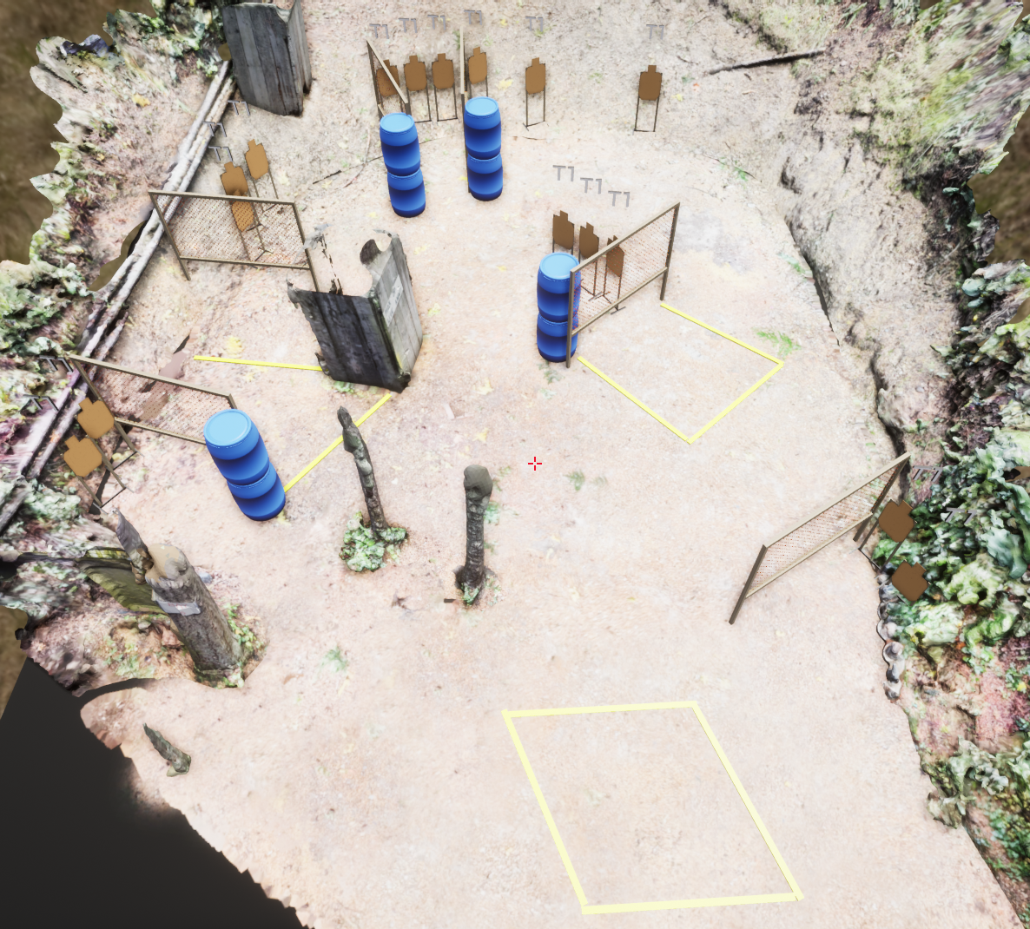
Stage 5
They Told Me This Was A Hoser Match
Course Designer: Eric Beerbaum

